Slide 1
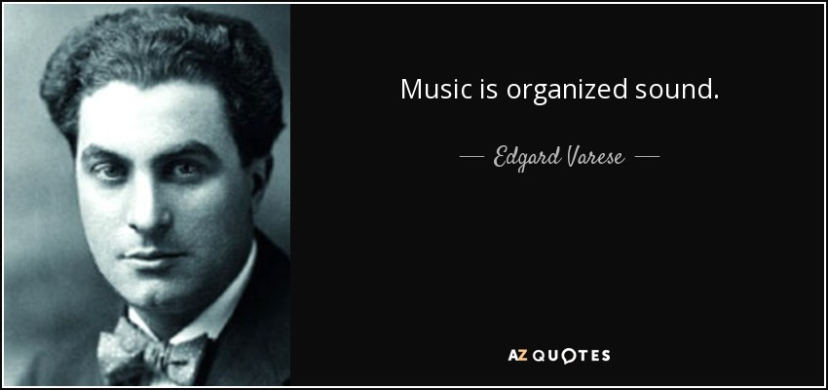
Edgard Varese
Written by:
Date of Submission: October 1, 2018

Slide 2
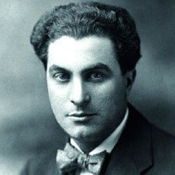
Brief Bio
He was born in December 22, 1883 in Paris France
Forced to move to his paternal family in Italy at age of 10.
He grew his interest in music and attended music lessons in Turin Italy
Edgard composed his first opera at age 12 and it was called Martin Pas
His father disapproved his interest in music and forced him to study engineering
He fled to Paris in 903
Edgard married Suzanna Bing in 1907 and they divorced in 1913
He made debut to America in 1917
He Died on November 6, 1965 (Meyer, Zimmerman & Paul Sacher Stiftung, 2006)

Slide 3
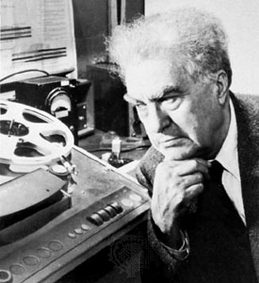
Musical Style
He is regarded as the “father of electronic” music
Edgard is regarded as the first person to construct electronic studio.
Further, he is termed as the first composer to include electronic instruments in his music.
Edgard used objects that were non-melodic like siren and Theremin in the creation of his complex music
He also had influence on free Jazz Music
Taught Jazz musician in 1957 to disregard the conventional time structures in recording (Davismoon, 2004).

Slide 4
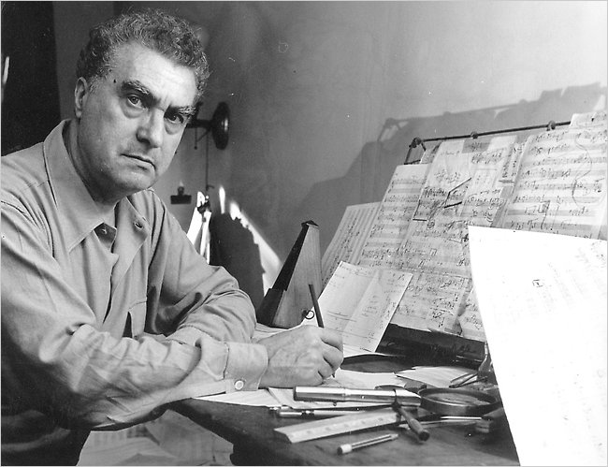
What Defines Edgard Verese Music?
Verese put much emphasis on timbre and rhythm of his music
He regarded his music as “organized sound.”
His music was rhythmically asymmetric, nonthematic, dissonant.
His conception of music was that it was “bodies of sounds in space.”
He believed that dissonance was fun (Marvin, 1991).

Slide 5
References
Meyer, F., Zimmerman, H., & Paul Sacher Stiftung (Basel, Switzerland). (2006). Edgard Varèse: Composer : sound sculptor : visionary. Woodbridge: The Boydell Press.
Davismoon, S. (2004). Edgard Varèse ... offerings. London: Routledge.
Marvin, E. W. (1991). The perception of rhythm in non-tonal music: Rhythmic contours in the music of Edgard Varèse. Music Theory Spectrum, 13(1), 61-78.

